Slide 1
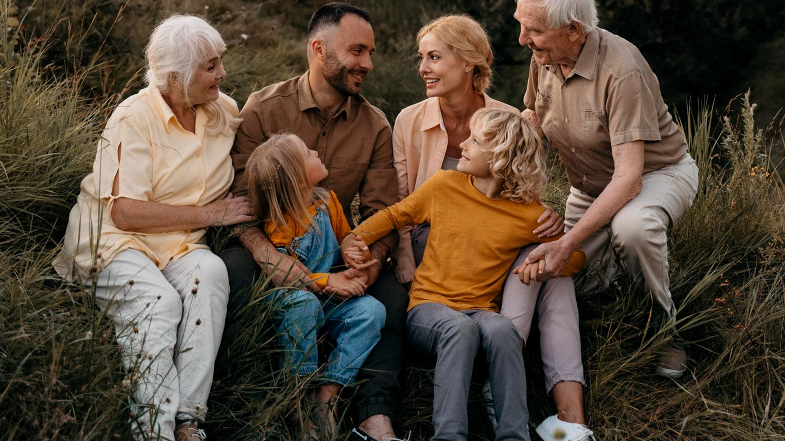
Granhub Online Community
The next steps
9TH GRADE
Strategic steps to ensure the platform's growth, engagement, and long-term success.

Slide 2
CONTENTS OF THIS TEMPLATE
Here’s what you’ll find in this Slidesgo template:
A slide structure based on a multi-purpose presentation for education, which you can easily adapt to your needs. For more info on how to edit the template, please visit Slidesgo School or read our FAQs.
To view this template in PowerPoint with the correct fonts, download and install on your computer the fonts that we have used. You can learn how to download and install fonts here.
An assortment of graphic resources that are suitable for use in the presentation can be found in the alternative resources slide.
A thanks slide, which you must keep so that proper credits for our design are given.
A resources slide, where you’ll find links to all the elements used in the template.
Instructions for use.
Final slides with:
The fonts and colors used in the template.
A selection of illustrations. You can also customize and animate them as you wish with the online editor. Visit Storyset to find more.
More infographic resources, whose size and color can be edited.
Sets of customizable icons of the following themes: general, business, avatar, creative process, education, help & support, medical, nature, performing arts, SEO & marketing, and teamwork.
You can delete this slide when you’re done editing the presentation.

Slide 3
TABLE OF CONTENTS
The family
Concepts
01
02
Features
Assignment
03
04
You can describe the topic of the section here
You can describe the topic of the section here
You can describe the topic of the section here
You can describe the topic of the section here

Slide 4

WHOA!
This can be the part of the presentation where you introduce yourself, write your email…

Slide 5

INTRODUCTION
You can give a brief description of the topic you want to talk about here. For example, if you want to talk about Mercury, you can say that it’s the smallest planet in the entire Solar System

Slide 6
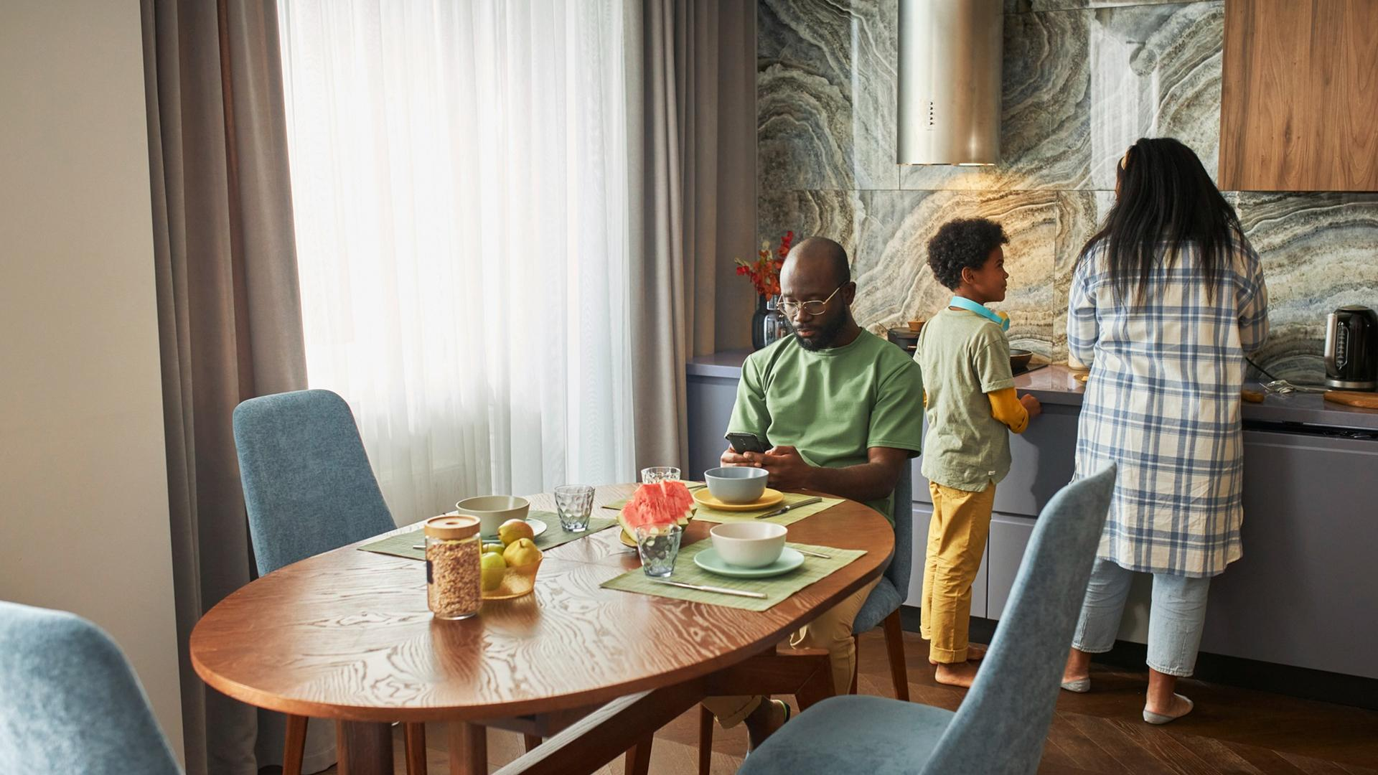
01
THE FAMILY
You can enter a subtitle here if you need it

Slide 7
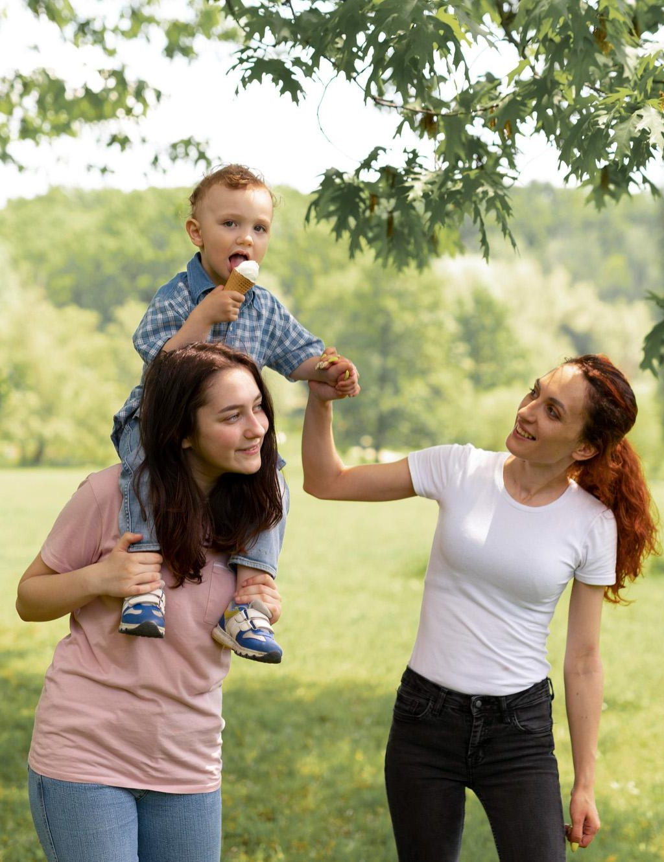
THE SLIDE TITLE GOES HERE!
Do you know what helps you make your point clear?
Lists like this one:
They’re simple
You can organize your ideas clearly
You’ll never forget to buy milk!
And the most important thing: the audience won’t miss the point of your presentation

Slide 8
FAMILY RELATIONSHIPS
Mercury
Venus
It’s the closest planet to the Sun and the smallest one in the Solar System—it’s only a bit larger than the Moon
Venus has a beautiful name and is the second planet from the Sun. It’s hot and has a poisonous atmosphere

Slide 9
TEENAGERS
Mercury
Venus
Mars
It’s the closest planet to the Sun and the smallest one in the Solar System
Venus has a beautiful name and is the second planet from the Sun
Despite being red, Mars is actually a cold place. It’s full of iron oxide dust

Slide 10
THE ROLE OF THE FAMILY
Venus
Jupiter
Mars
Saturn
Venus is the second planet from the Sun
Jupiter is the biggest planet in the Solar System
Despite being red, Mars is actually a cold place
It’is composed mostly of hydrogen and helium

Slide 11
MANY TYPES OF FAMILY
Mercury
Venus
Mars
Jupiter
Saturn
Neptune
01
02
03
It’s the closest planet to the Sun
Venus is the second planet from the Sun
Despite being red, Mars is actually cold
04
05
06
Jupiter is the biggest planet of them all
It’s composed of hydrogen and helium
It’s the farthest planet from the Sun

Slide 12
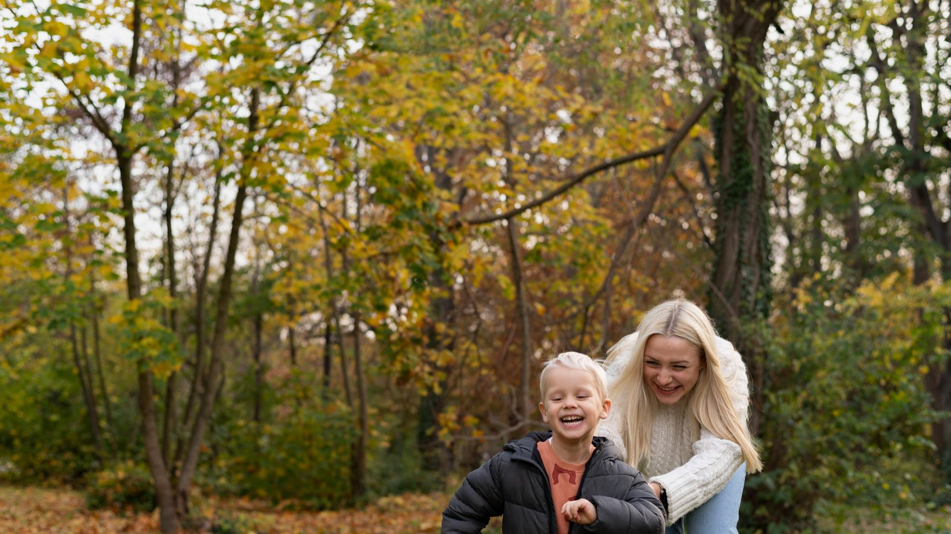
AWESOME WORDS

Slide 13

—SOMEONE FAMOUS
“This is a quote, words full of wisdom that someone important said and can make the reader get inspired.”

Slide 14
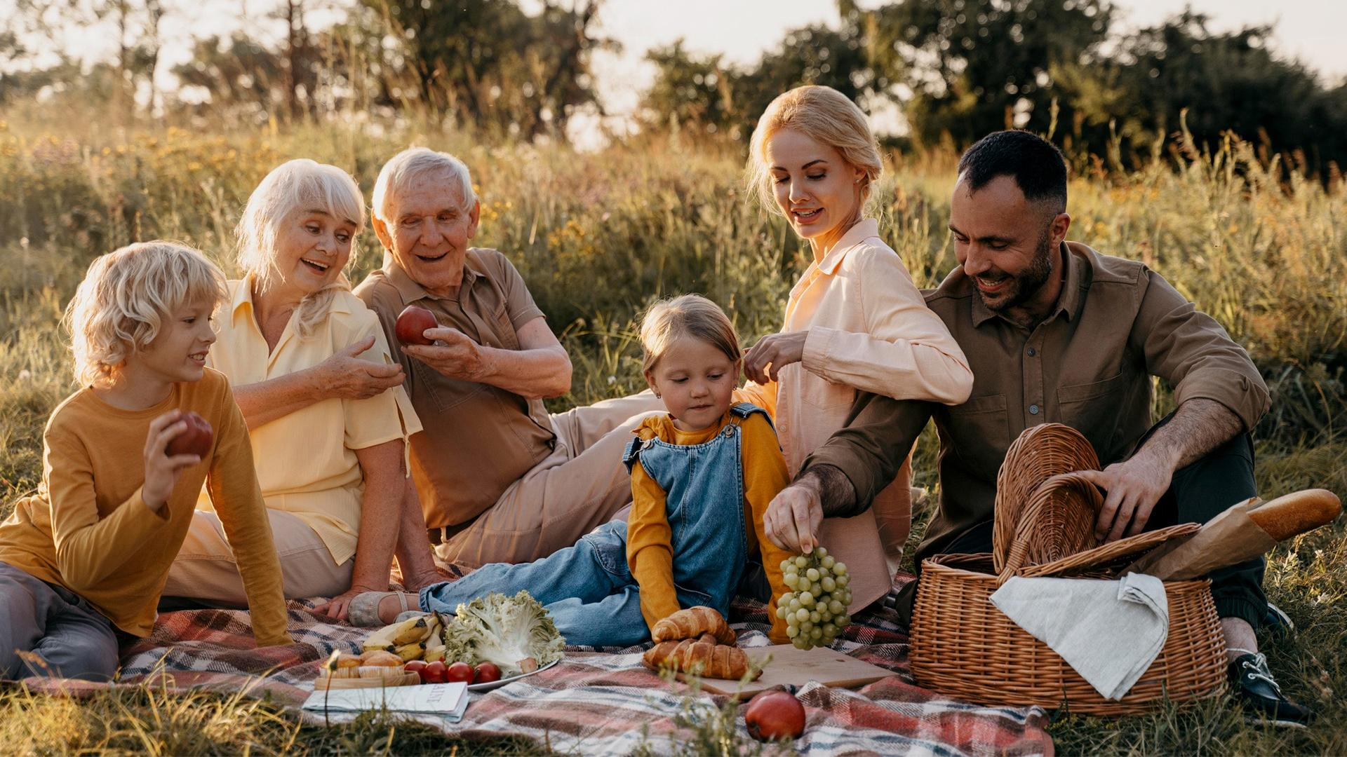
A PICTURE IS WORTH A THOUSAND WORDS

Slide 15

A PICTURE ALWAYS REINFORCES THE CONCEPT
Images reveal large amounts of data, so remember: use an image instead of a long text. Your audience will appreciate it

Slide 16

02
CONCEPTS
You can enter a subtitle here if you need it

Slide 17

150,000
Big numbers catch your audience’s attention

Slide 18
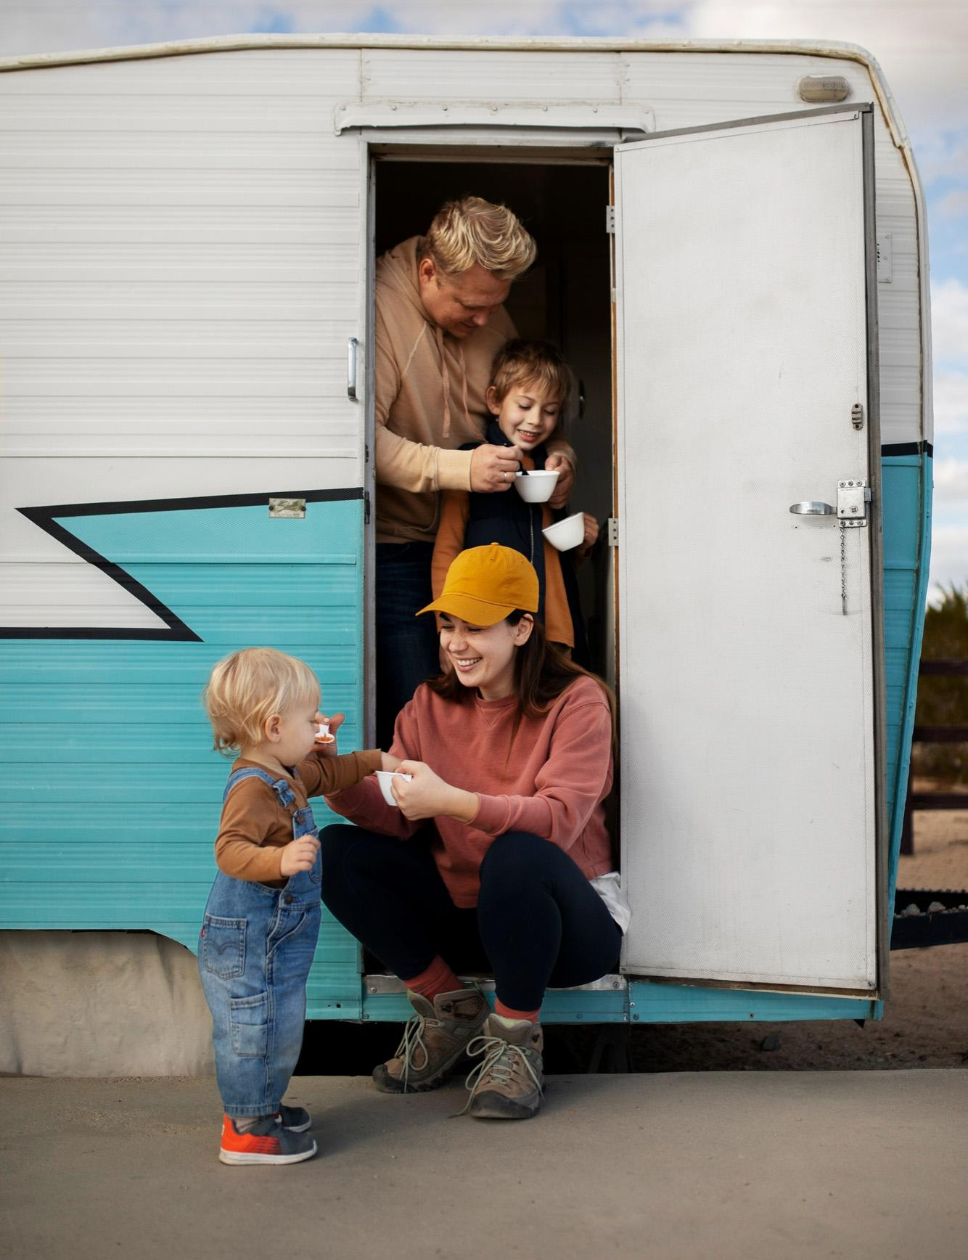
9h 55m 23s
333,000
386,000 km
Jupiter's rotation period
The Sun’s mass compared to Earth’s
Distance between Earth and the Moon

Slide 19
LET’S USE SOME PERCENTAGES
50%
60%
75%
Mars
Neptune
Venus
Despite being red, Mars is actually cold
Neptune is the farthest planet from the Sun
Venus is the second planet from the Sun

Slide 20
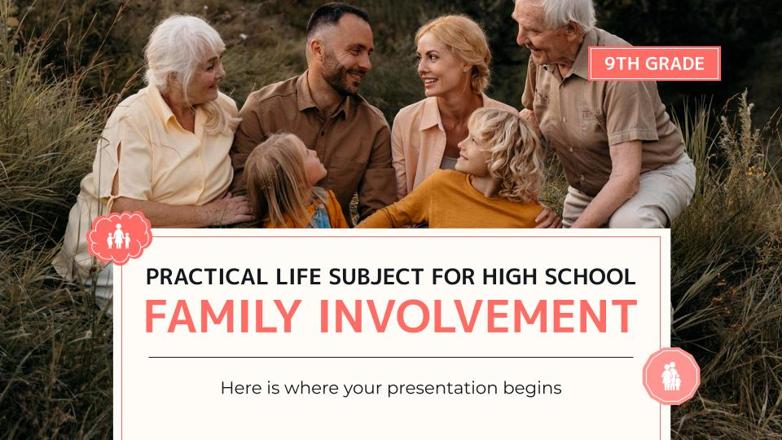
DESKTOP
You can replace the image on the screen with your own work. Just right-click on it and select “Replace image”

Slide 21
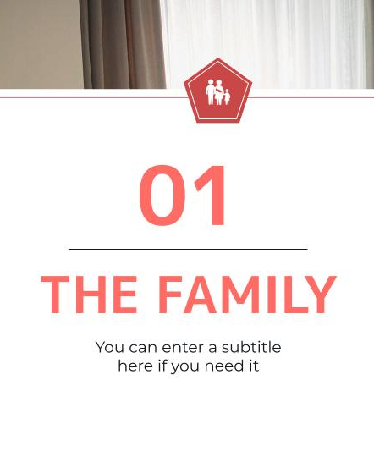
TABLET APP
You can replace the image on the screen with your own work. Just right-click on it and select “Replace image”

Slide 22
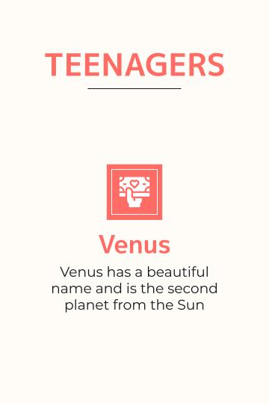
SMARTPHONE
You can replace the image on the screen with your own work. Just right-click on it and select “Replace image”

Slide 23

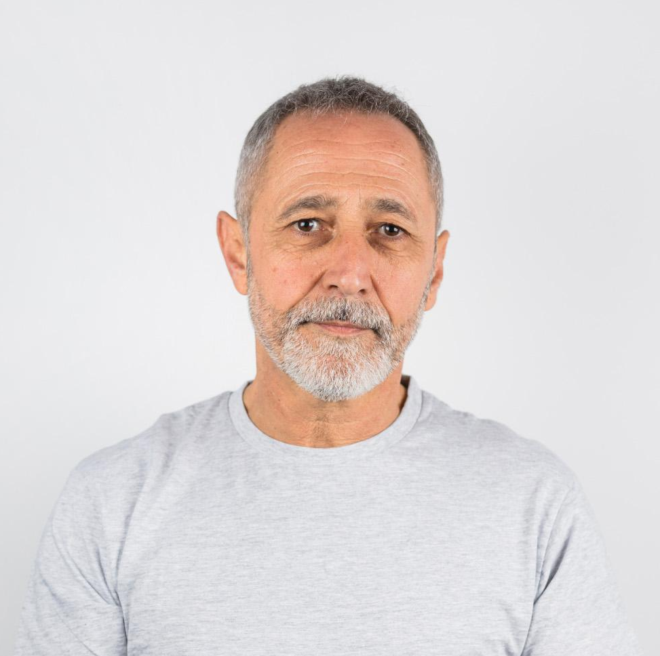

OUR TEACHERS
Jenna Doe
John Lee
Susan Bones
You can speak a bit about this person here
You can speak a bit about this person here
You can speak a bit about this person here

Slide 24

03
FEATURES
You can enter a subtitle here if you need it

Slide 25
THIS IS A MAP
Jupiter
Mercury
Jupiter is the biggest planet of them all
Mercury is the closest planet to the Sun

Slide 26
A FAMILY TIMELINE
Mars is actually a cold place
Earth is where we all live
Mercury is the smallest planet
Mars
Earth
Mercury
01
02
03
04
05
Neptune
Jupiter
Neptune is far away from us
Jupiter is the biggest planet

Slide 27
FAMILY DYNAMICS
Trauma in
the family
Venus has a beautiful name and is the second planet from the Sun. It’s terribly hot there
Mental illness in the family
Earth is the third planet from the Sun and the only one that harbors life in the Solar System
Addiction in the family
Saturn is a gas giant with several rings and it’s composed of hydrogen and helium

Slide 28
FAMILY SKILLS
Love and affection
Earth is where we all live
Stress management
Jupiter is the biggest planet
Relationships skills
Mars is actually a cold place
Independence skills
Venus is hotter than Mercury
Modeling learning
Mercury is very small

Slide 29
FAMILY SUPPORTS
01 | 02 | 03 | 04
Social support | Emotional support | Physical support | Academic support
Venus is the second planet from the Sun | Jupiter is the biggest planet of them all | Neptune is the farthest planet from the Sun | Mercury is the closest planet to the Sun

Slide 30

FAMILY RESPONSIBILITIES
25%
25%
Meet needs
Teach values
Mercury is very small
Mars is actually cold
25%
25%
Teach rules
Follow the link in the graph to modify its data and then paste the new one here. For more info, click here
Set limits
Jupiter is very big
Neptune is cold

Slide 31
6 TYPES OF FAMILY INVOLVEMENT
Decision-making
Home learning
Mars is actually a cold place
Neptune is far away from us
Parenting
Volunteering
Jupiter is the biggest planet
Mercury is the smallest planet
Communicating
Collaborating
Venus is hotter than Mercury
Earth is where we all live

Slide 32
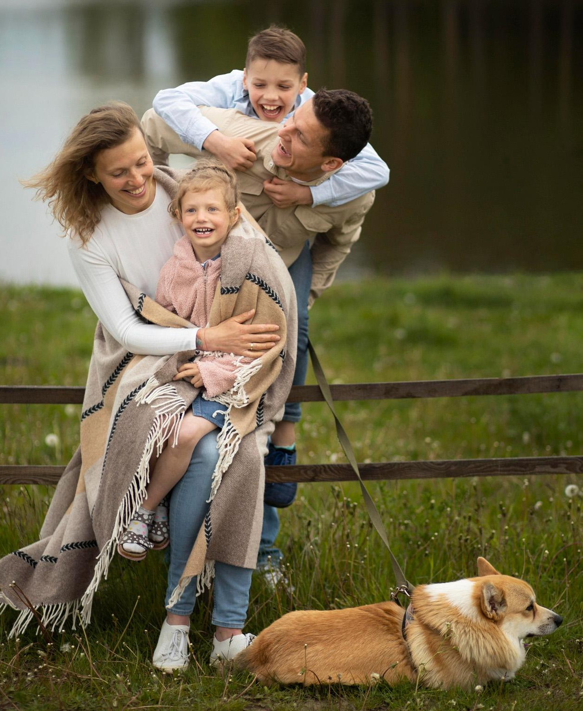
FAMILY ROLES
Mother
Father
Venus is the second planet from the Sun
Jupiter is the biggest planet of them all
Brother
Pet
Despite being red, Mars is a cold place
Saturn is a gas giant and has several rings

Slide 33
REFERENCES
Write your bibliographical references here
Write your bibliographical references here
Write your bibliographical references here
Write your bibliographical references here
Write your bibliographical references here
Write your bibliographical references here
Write your bibliographical references here
Write your bibliographical references here
Write your bibliographical references here
Write your bibliographical references here
Write your bibliographical references here
Write your bibliographical references here
Write your bibliographical references here

Slide 34
SIGNS OF A HEALTHY FAMILY
Healthy family
Unhealthy family
Jupiter is a very big planet
Respect
Venus has a nice name
Mercury a small planet
Dignity
Pluto is a dwarf planet
Earth is where we live
Diversity
Neptune is far away
Mars is a cold place
Trust
Saturn is a gas giant

Slide 35

THANKS!
Do you have any questions?
youremail@freepik.com
+91 620 421 838
yourcompany.com
Please keep this slide for attribution

Slide 36
ICON PACK: GLOBAL DAY OF PARENTS

Slide 37
ALTERNATIVE RESOURCES
Here’s an assortment of alternative resources whose style fits the one of this template:
Family silhouettes pack

Slide 38
RESOURCES
Did you like the resources on this template? Get them for free at our other websites:
Photos
Happy family outdoors full shot
Full shot happy family and dog outdoors
Full shot happy family flying kite
Cheerful girl on the shoulders of her father
Beautiful lgbt family in the park
Full shot happy lgbt family
Mothers day concept with daughter kissing mother
African mother and little girl close up
Full shot happy family in nature
Front view of happy family with copy space
Full shot happy family at home
Full shot family with camper van
Young mother spending time with her baby
Mother spending time with her child
Cute family spending quality time together
Vectors
Family silhouettes pack
Icons
Icon Pack: Global Day of Parents

Slide 39
Instructions for use
If you have a free account, in order to use this template, you must credit Slidesgo by keeping the Thanks slide. Please refer to the next slide to read the instructions for premium users.
As a Free user, you are allowed to:
- Modify this template.
- Use it for both personal and commercial projects.
You are not allowed to:
- Sublicense, sell or rent any of Slidesgo Content (or a modified version of Slidesgo Content).
- Distribute Slidesgo Content unless it has been expressly authorized by Slidesgo.
- Include Slidesgo Content in an online or offline database or file.
- Offer Slidesgo templates (or modified versions of Slidesgo templates) for download.
- Acquire the copyright of Slidesgo Content.
For more information about editing slides, please read our FAQs or visit Slidesgo School:
https://slidesgo.com/faqs and https://slidesgo.com/slidesgo-school

Slide 40
Instructions for use (premium users)
As a Premium user, you can use this template without attributing Slidesgo or keeping the "Thanks" slide.
You are allowed to:
Modify this template.
Use it for both personal and commercial purposes.
Hide or delete the “Thanks” slide and the mention to Slidesgo in the credits.
Share this template in an editable format with people who are not part of your team.
You are not allowed to:
Sublicense, sell or rent this Slidesgo Template (or a modified version of this Slidesgo Template).
Distribute this Slidesgo Template (or a modified version of this Slidesgo Template) or include it in a database or in any other product or service that offers downloadable images, icons or presentations that may be subject to distribution or resale.
Use any of the elements that are part of this Slidesgo Template in an isolated and separated way from this Template.
Register any of the elements that are part of this template as a trademark or logo, or register it as a work in an intellectual property registry or similar.
For more information about editing slides, please read our FAQs or visit Slidesgo School:
https://slidesgo.com/faqs and https://slidesgo.com/slidesgo-school

Slide 41
Fonts & colors used
This presentation has been made using the following fonts:
M PLUS 1
(https://fonts.google.com/specimen/M+PLUS+1)
Montserrat
(https://fonts.google.com/specimen/Montserrat)
#13181e
#ffffff
#ff6b65
#fffbf6
#ff9590
#c94747
#fcb1ae

Slide 42
Storyset
Create your Story with our illustrated concepts. Choose the style you like the most, edit its colors, pick the background and layers you want to show and bring them to life with the animator panel! It will boost your presentation. Check out how it works.
Pana
Amico
Bro
Rafiki
Cuate

Slide 43
Use our editable graphic resources...
You can easily resize these resources without losing quality. To change the color, just ungroup the resource and click on the object you want to change. Then, click on the paint bucket and select the color you want. Group the resource again when you’re done. You can also look for more infographics on Slidesgo.

Slide 46
JANUARY
FEBRUARY
MARCH
APRIL
MAY
JUNE
PHASE 1
Task 1
Task 2
PHASE 2
Task 1
Task 2
JANUARY
FEBRUARY
MARCH
APRIL
PHASE 1
Task 1
Task 2

Slide 49
...and our sets of editable icons
You can resize these icons without losing quality.
You can change the stroke and fill color; just select the icon and click on the paint bucket/pen.
In Google Slides, you can also use Flaticon’s extension, allowing you to customize and add even more icons.

Slide 50
Educational Icons
Medical Icons

Slide 51
Business Icons
Teamwork Icons

Slide 52
Help & Support Icons
Avatar Icons

Slide 53
Creative Process Icons
Performing Arts Icons

Slide 54
Nature Icons

Slide 55
SEO & Marketing Icons

Slide 56


